Slide 1


Titolo presentazione sottotitolo
Interplanetary trajectory design
&
Planetary perturbations analysis
Milano, XX mese 20XX
Orbital Mechanics project – 2023/24
Marcello Pareschi
Daniele Paternoster
Alex Cristian Turcu
Tamim Harun Or
Project ID: 2319

Slide 2
Table of contents
1° Assignment :
Description of the problem.
Algorithms.
Time domain reduction.
Results.
2° Assignment:
Ground track.
Propagation with perturbations (J2 + Moon).
Filtering.
Comparison with real data.

Slide 3
Problem overview and assigned data
Mission:
Departure at Mars.
Fly-By at Earth.
Arrival at 1036 Ganymed.
Preliminary assumptions:
patched conics method.
injection and rendezvous hyperbolae not considered.
impulsive manoeuvre.
Constraints:
Time window: [01/01/2028, 01/01/2058].
TOF1 and TOF2 greater than parabolic time.
Minimum pericentre altitude.

Slide 4
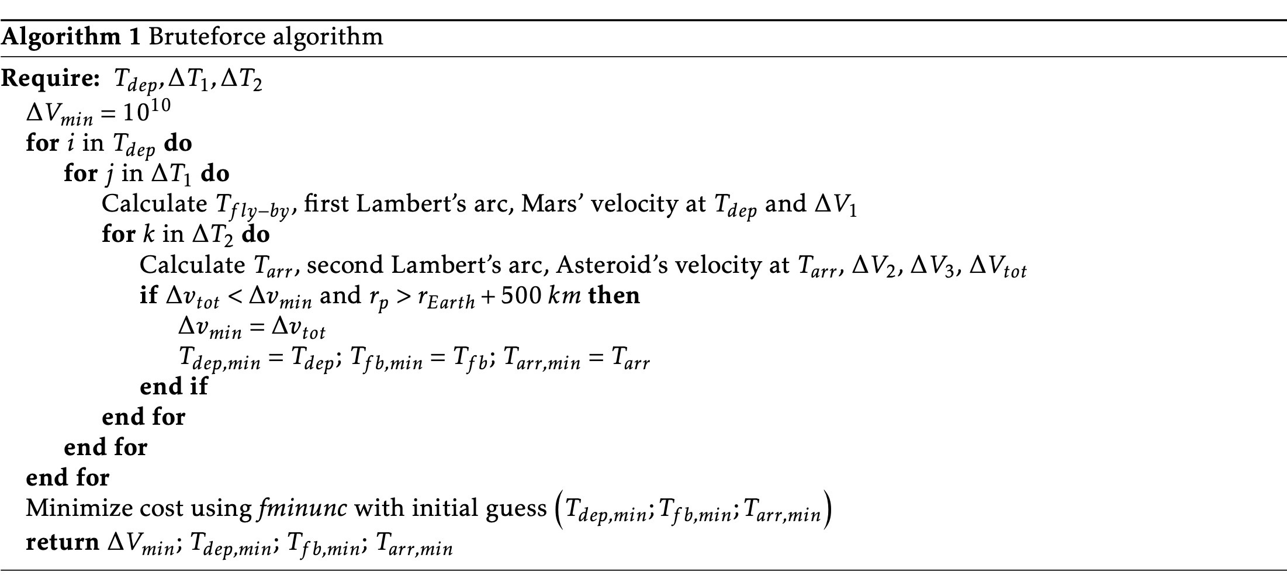
Algorithms: brute-force and refined brute-force

Slide 5
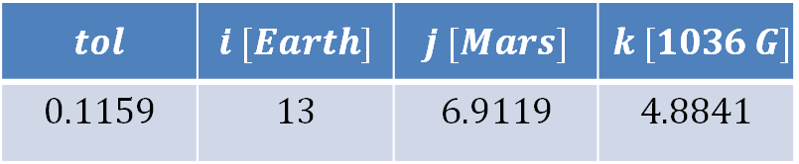
Time domain reduction (1): resonance and synodic period.
First restriction → repetition of celestial body positions.
Synodic period → not viable for non-circular orbits.
Resonance period is introduced.
Perfect resonance is impossible → a tolerance must be introduced.
$$tol$$ | $$i [Earth]$$ | $$j [Mars]$$ | $$k [1036 G]$$
$$0.1159$$ | $$13$$ | $$6.9119$$ | $$4.8841$$

Slide 6
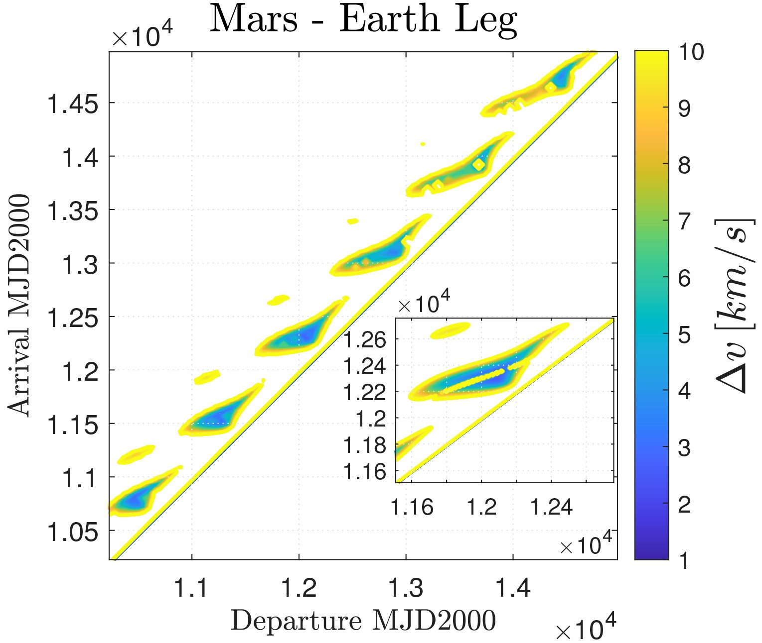
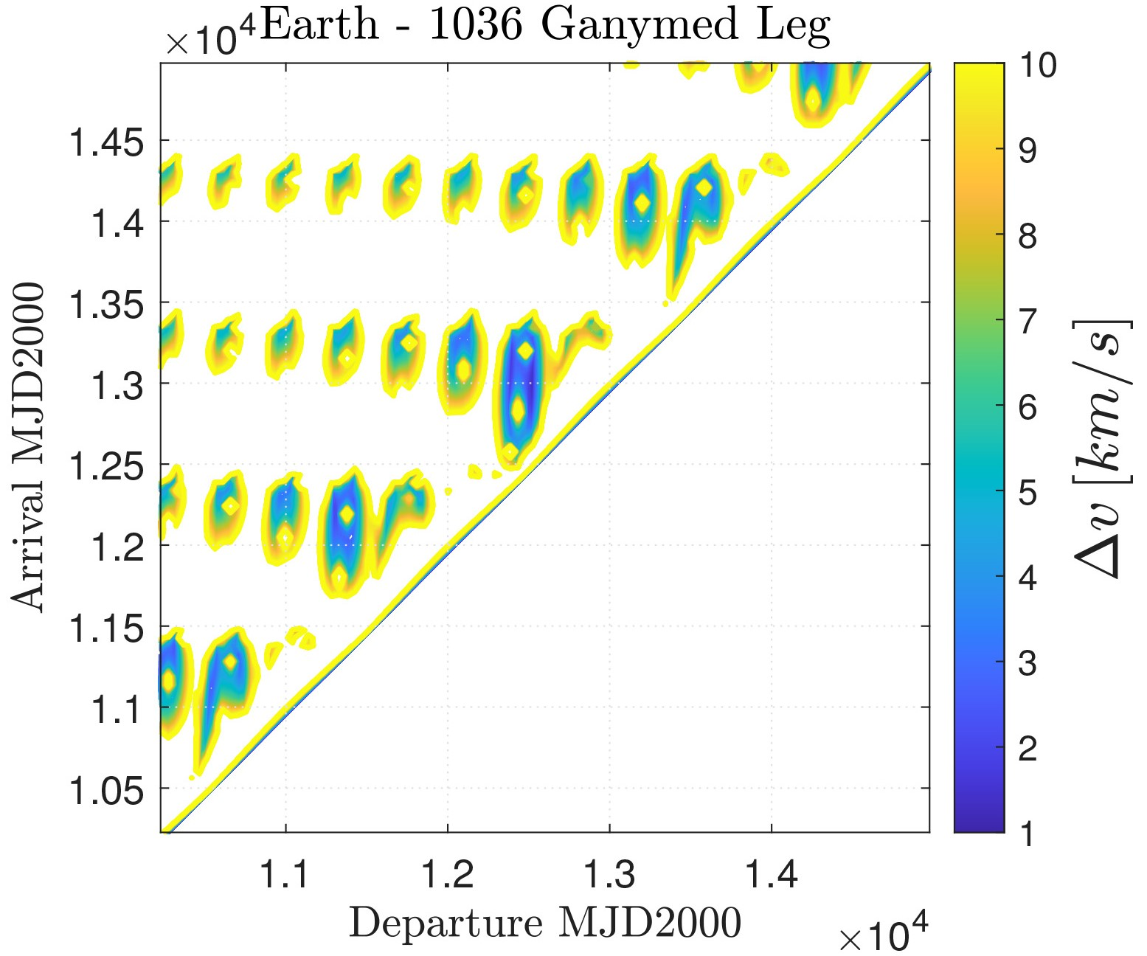
Time domain reduction (2): cost plots - analysis.

Slide 7
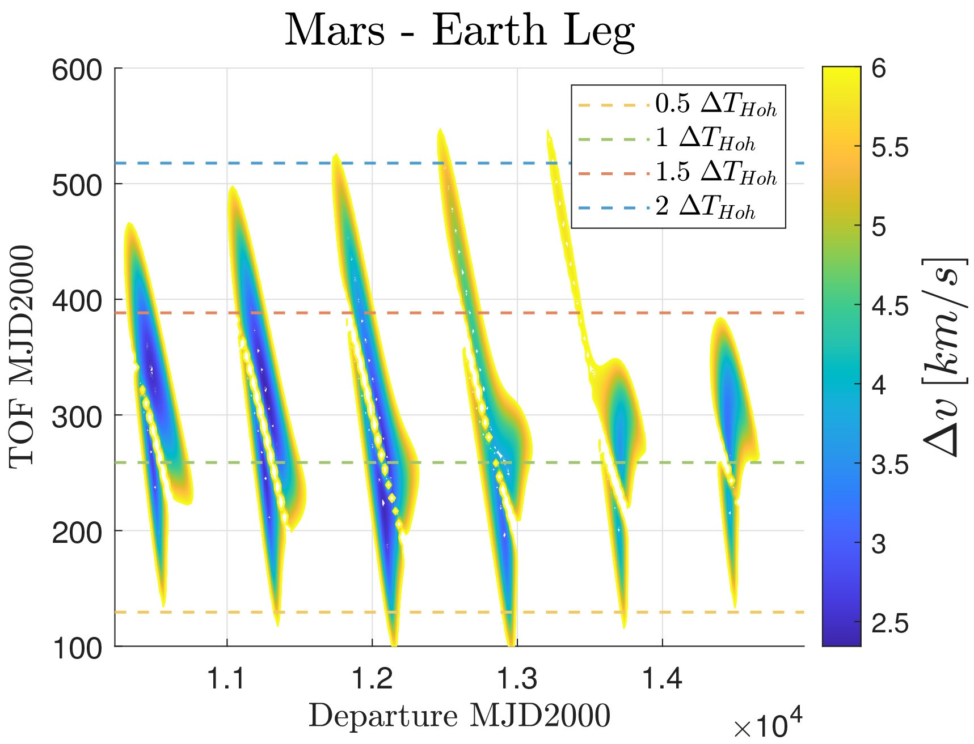
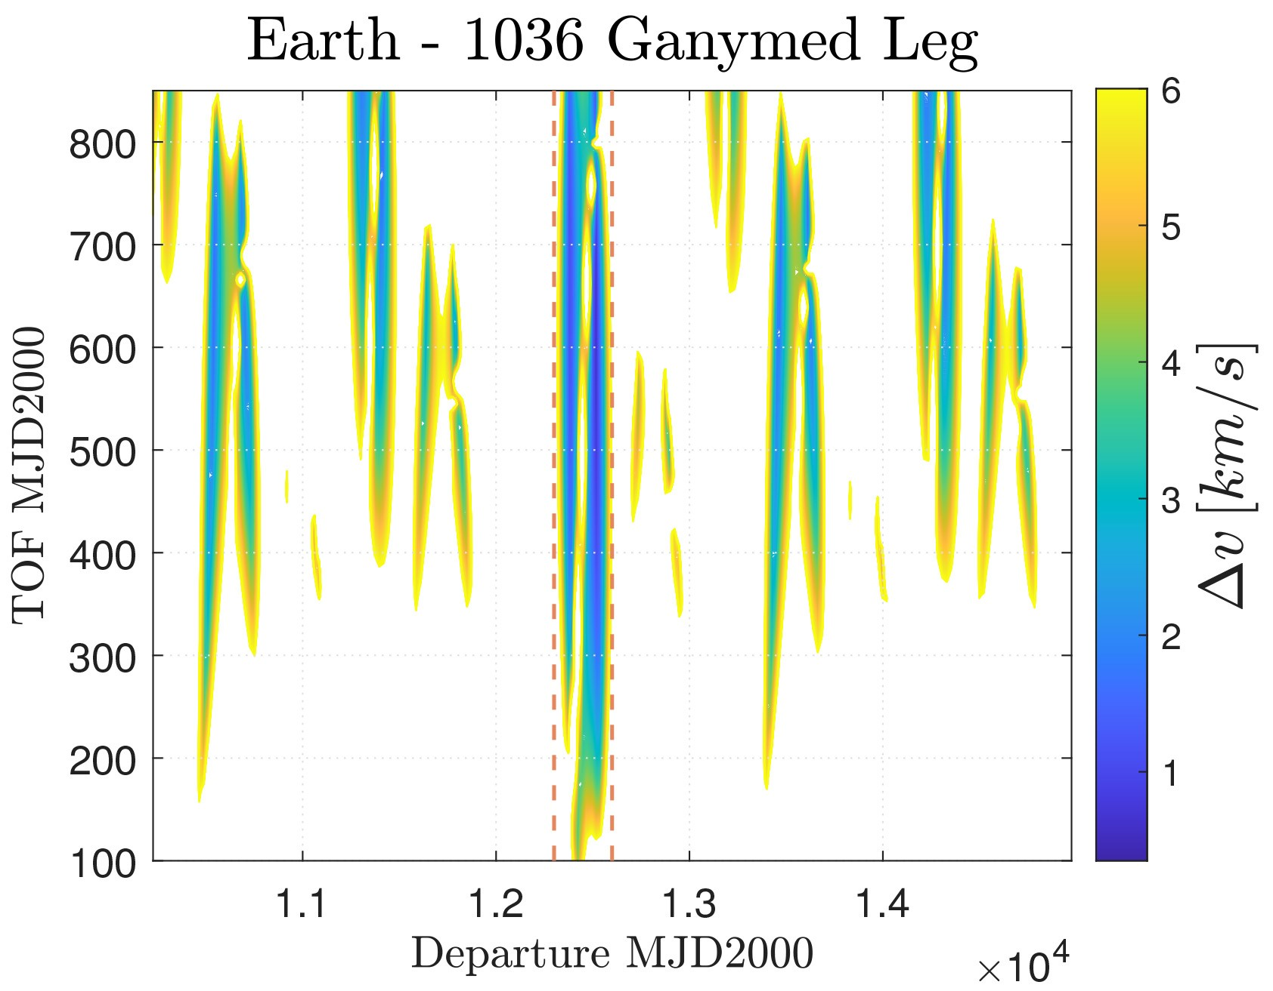
Time domain reduction (3): cost plots with TOFs - analysis.

Slide 8
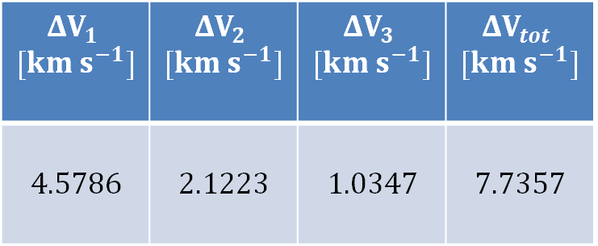
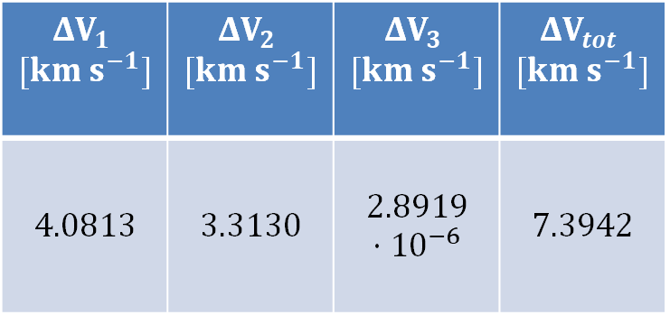
Final selection and results (1) – algorithms’ comparison
Brute-force refined algorithm (40 elements)
$$ΔV_{1}$$ $$[km s^{−1}]$$ | $$ΔV_{2}$$ $$[km s^{−1}]$$ | $$ΔV_{3}$$ $$[km s^{−1}]$$ | $$ΔV_{tot}$$ $$[km s^{−1}]$$
$$4.0813$$ | $$3.3130$$ | $$2.8919⋅{10}^{−6}$$ | $$7.3942$$
DEP. date | FB date | ARR. date
[03/06/2033] | [10/02/2034] | [27/03/2036]
Brute-force algorithm (100 elements)
$$ΔV_{1}$$ $$[km s^{−1}]$$ | $$ΔV_{2}$$ $$[km s^{−1}]$$ | $$ΔV_{3}$$ $$[km s^{−1}]$$ | $$ΔV_{tot}$$ $$[km s^{−1}]$$
$$4.5786$$ | $$2.1223$$ | $$1.0347$$ | $$7.7357$$
DEP. date | FB date | ARR. date
[07/07/2033] | [04/03/2034] | [23/03/2035]

Slide 9
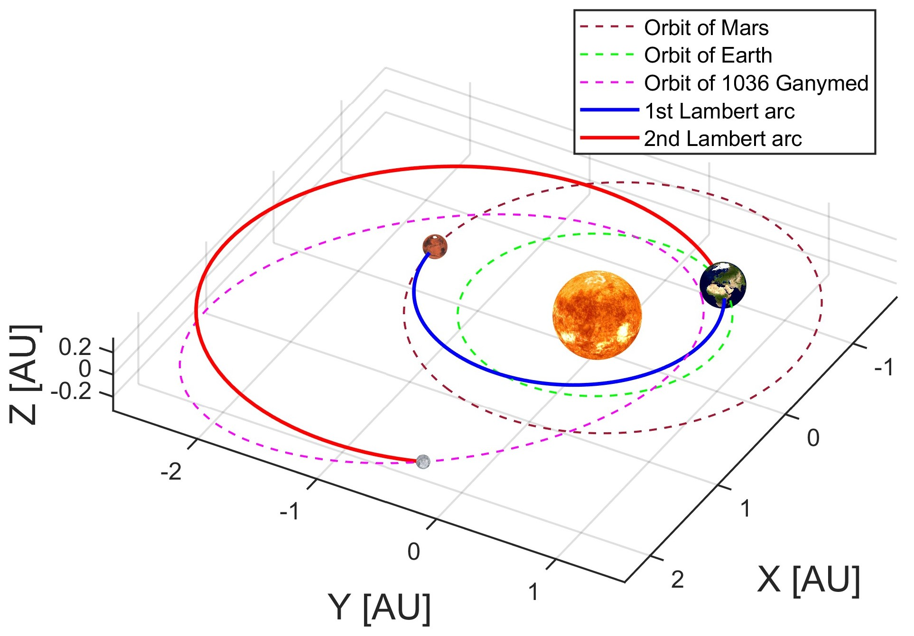
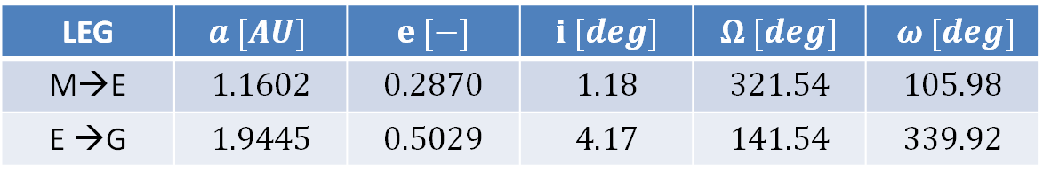
Final selection and results (2) – interplanetary legs
LEG | $$a [AU]$$ | $$e [−]$$ | $$i [deg]$$ | $$Ω [deg]$$ | $$ω [deg]$$
M→E | $$1.1602$$ | $$0.2870$$ | $$1.18$$ | $$321.54$$ | $$105.98$$
E →G | $$1.9445$$ | $$0.5029$$ | $$4.17$$ | $$141.54$$ | $$339.92$$

Slide 10
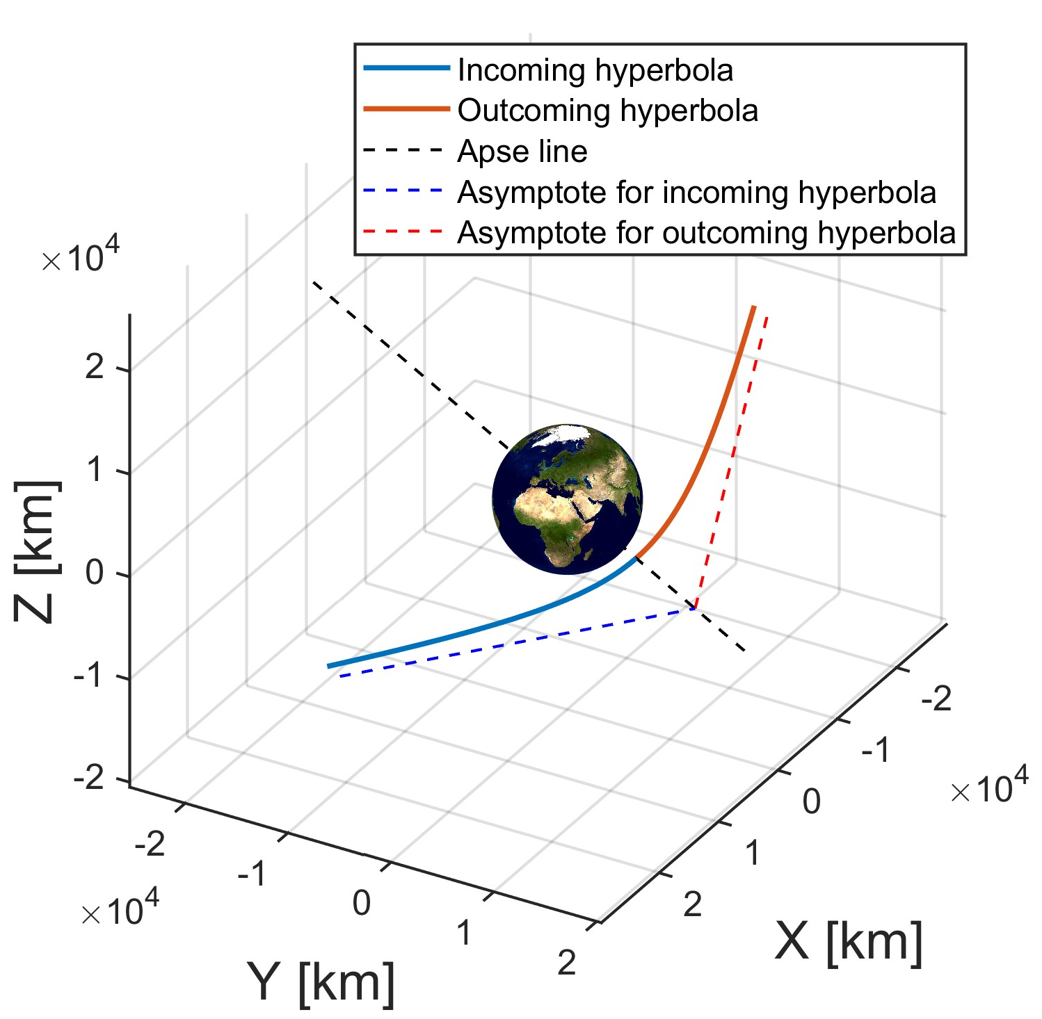
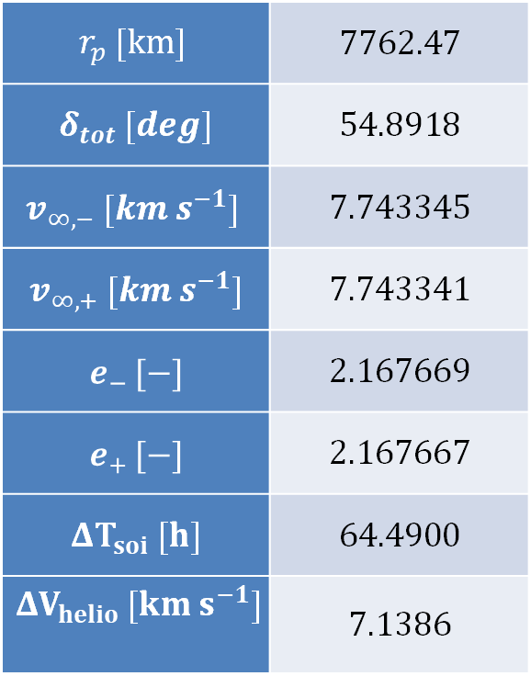
Final selection and results (3) – gravity assist
$$r_{p} [km]$$ | $$7762.47$$
$δ_{tot} [deg]$ | $$54.8918$$
$$v_{∞,−} [km s^{−1}]$$ | $$7.743345$$
$$v_{∞,+} [km s^{−1}]$$ | $$7.743341$$
$$e_{− }[−]$$ | $$2.167669$$
$$e_{+ }[−]$$ | $$2.167667$$
$$ΔT_{soi} [h]$$ | $$64.4900$$
$$ΔV_{helio} [km s^{−1}]$$ | $$7.1386$$

Slide 11
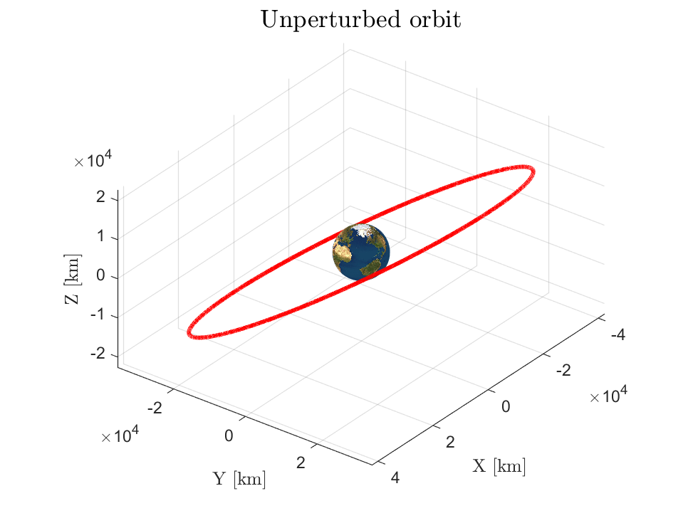
Assignment 2: Planetary Explorer Mission
a [km] | e [-] | i [deg]
42159 | 0.0007 | 32.5934
Ω [deg] | ω [deg] | hp [km]
0 | 85 | 35786
Assigned Data
Nominal Orbit

Slide 12
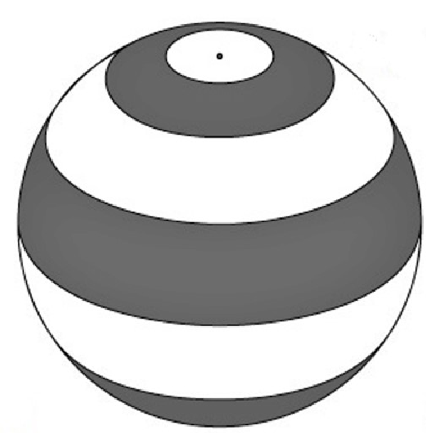
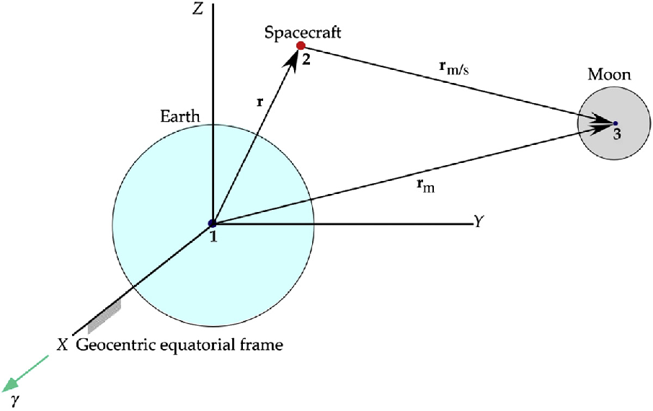
Assigned Perturbations
J2 Effect
Moon Disturbance

Slide 13
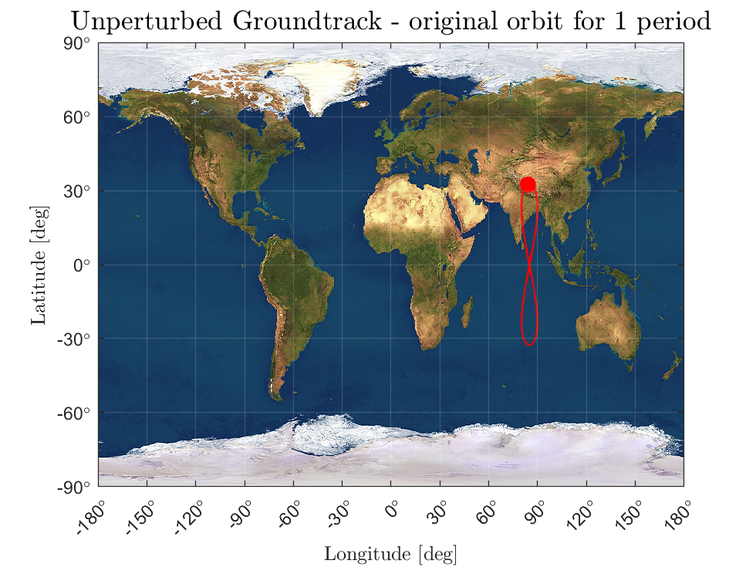
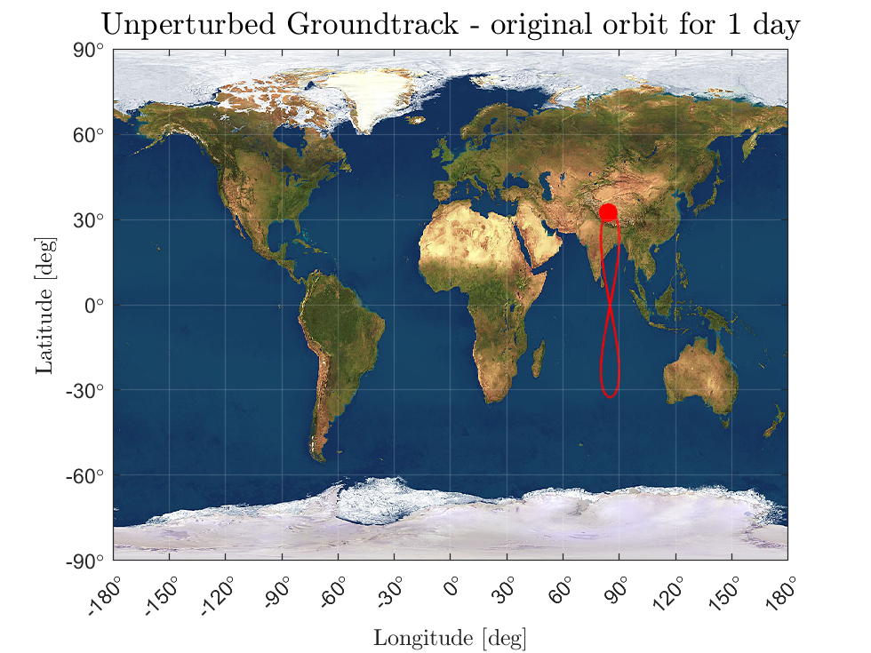
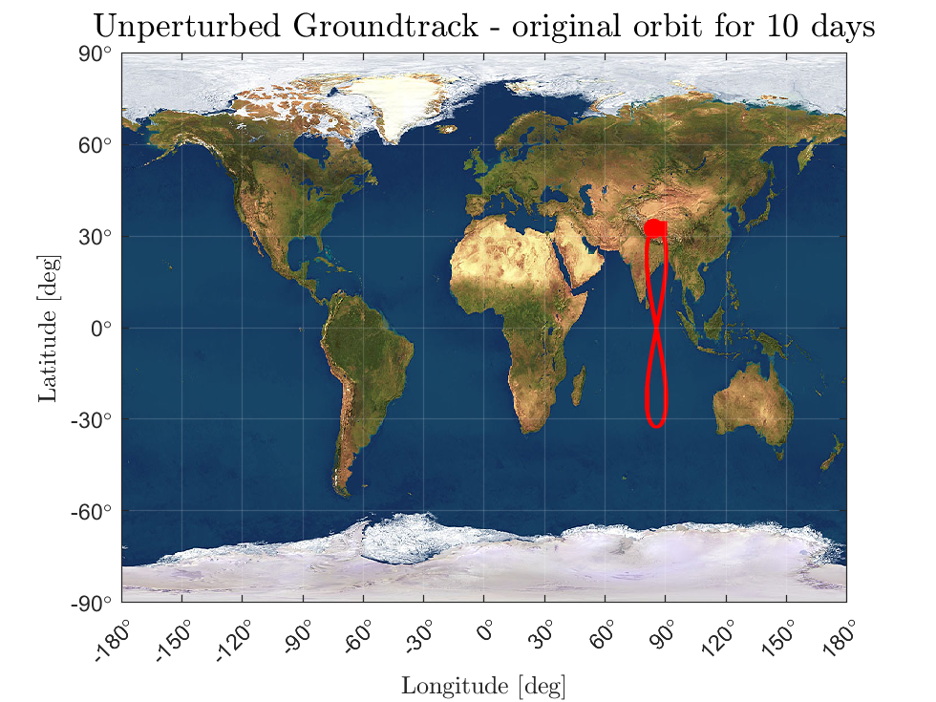
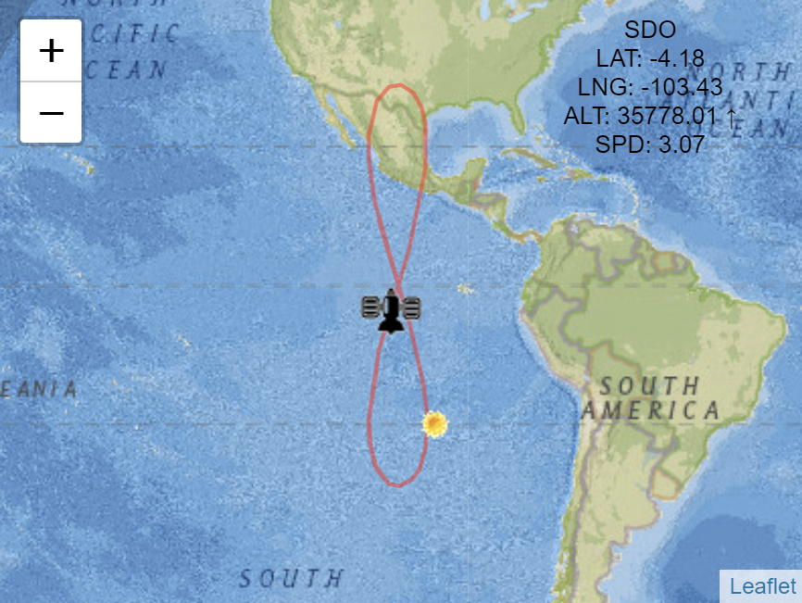
Unperturbed Groundtrack (Nominal Orbit)

Slide 14


Unperturbed Groundtrack (Repeating Orbit)
k:m = 1:1
a = 42166

Slide 15
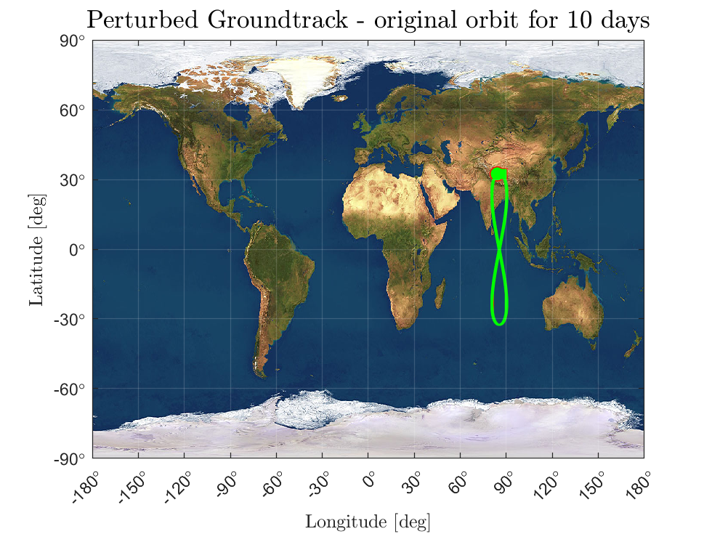

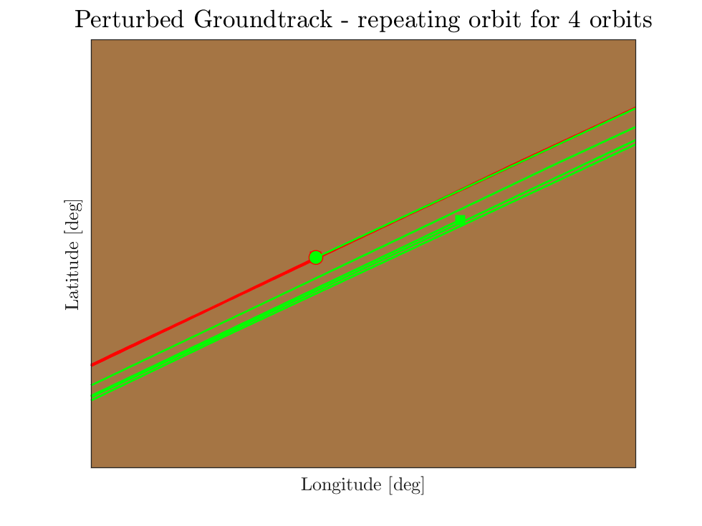
Perturbed Groundtracks (Nominal and Repeating)

Slide 16
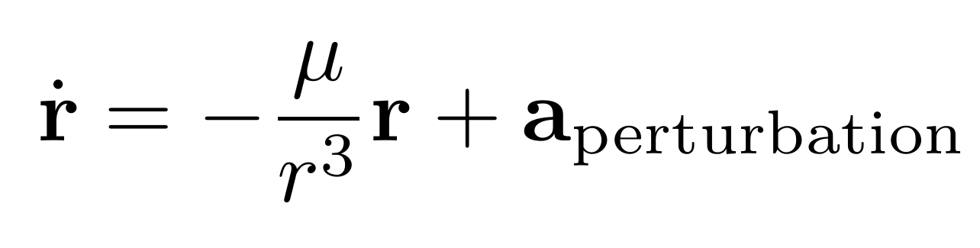
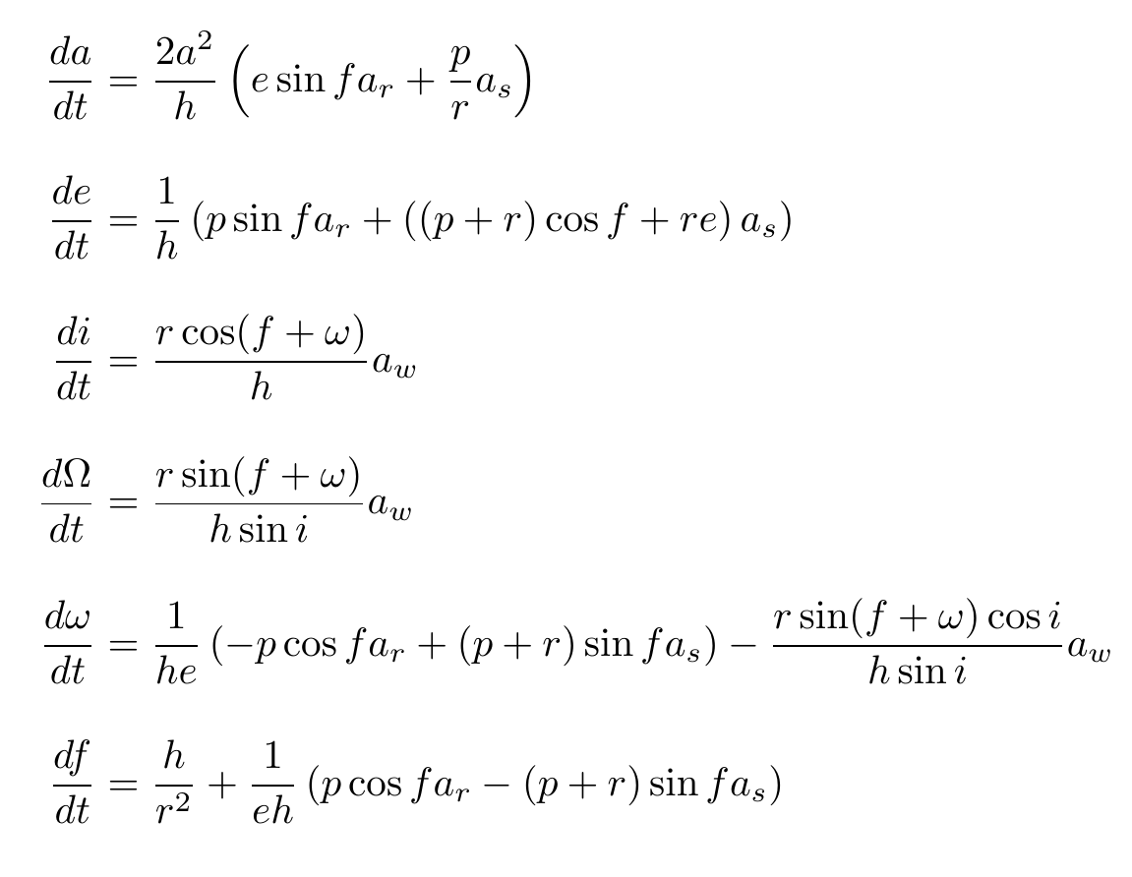
Orbit Propagation Methods
Cartesian Co-ordinates
Gauss' Planetary Equations

Slide 17
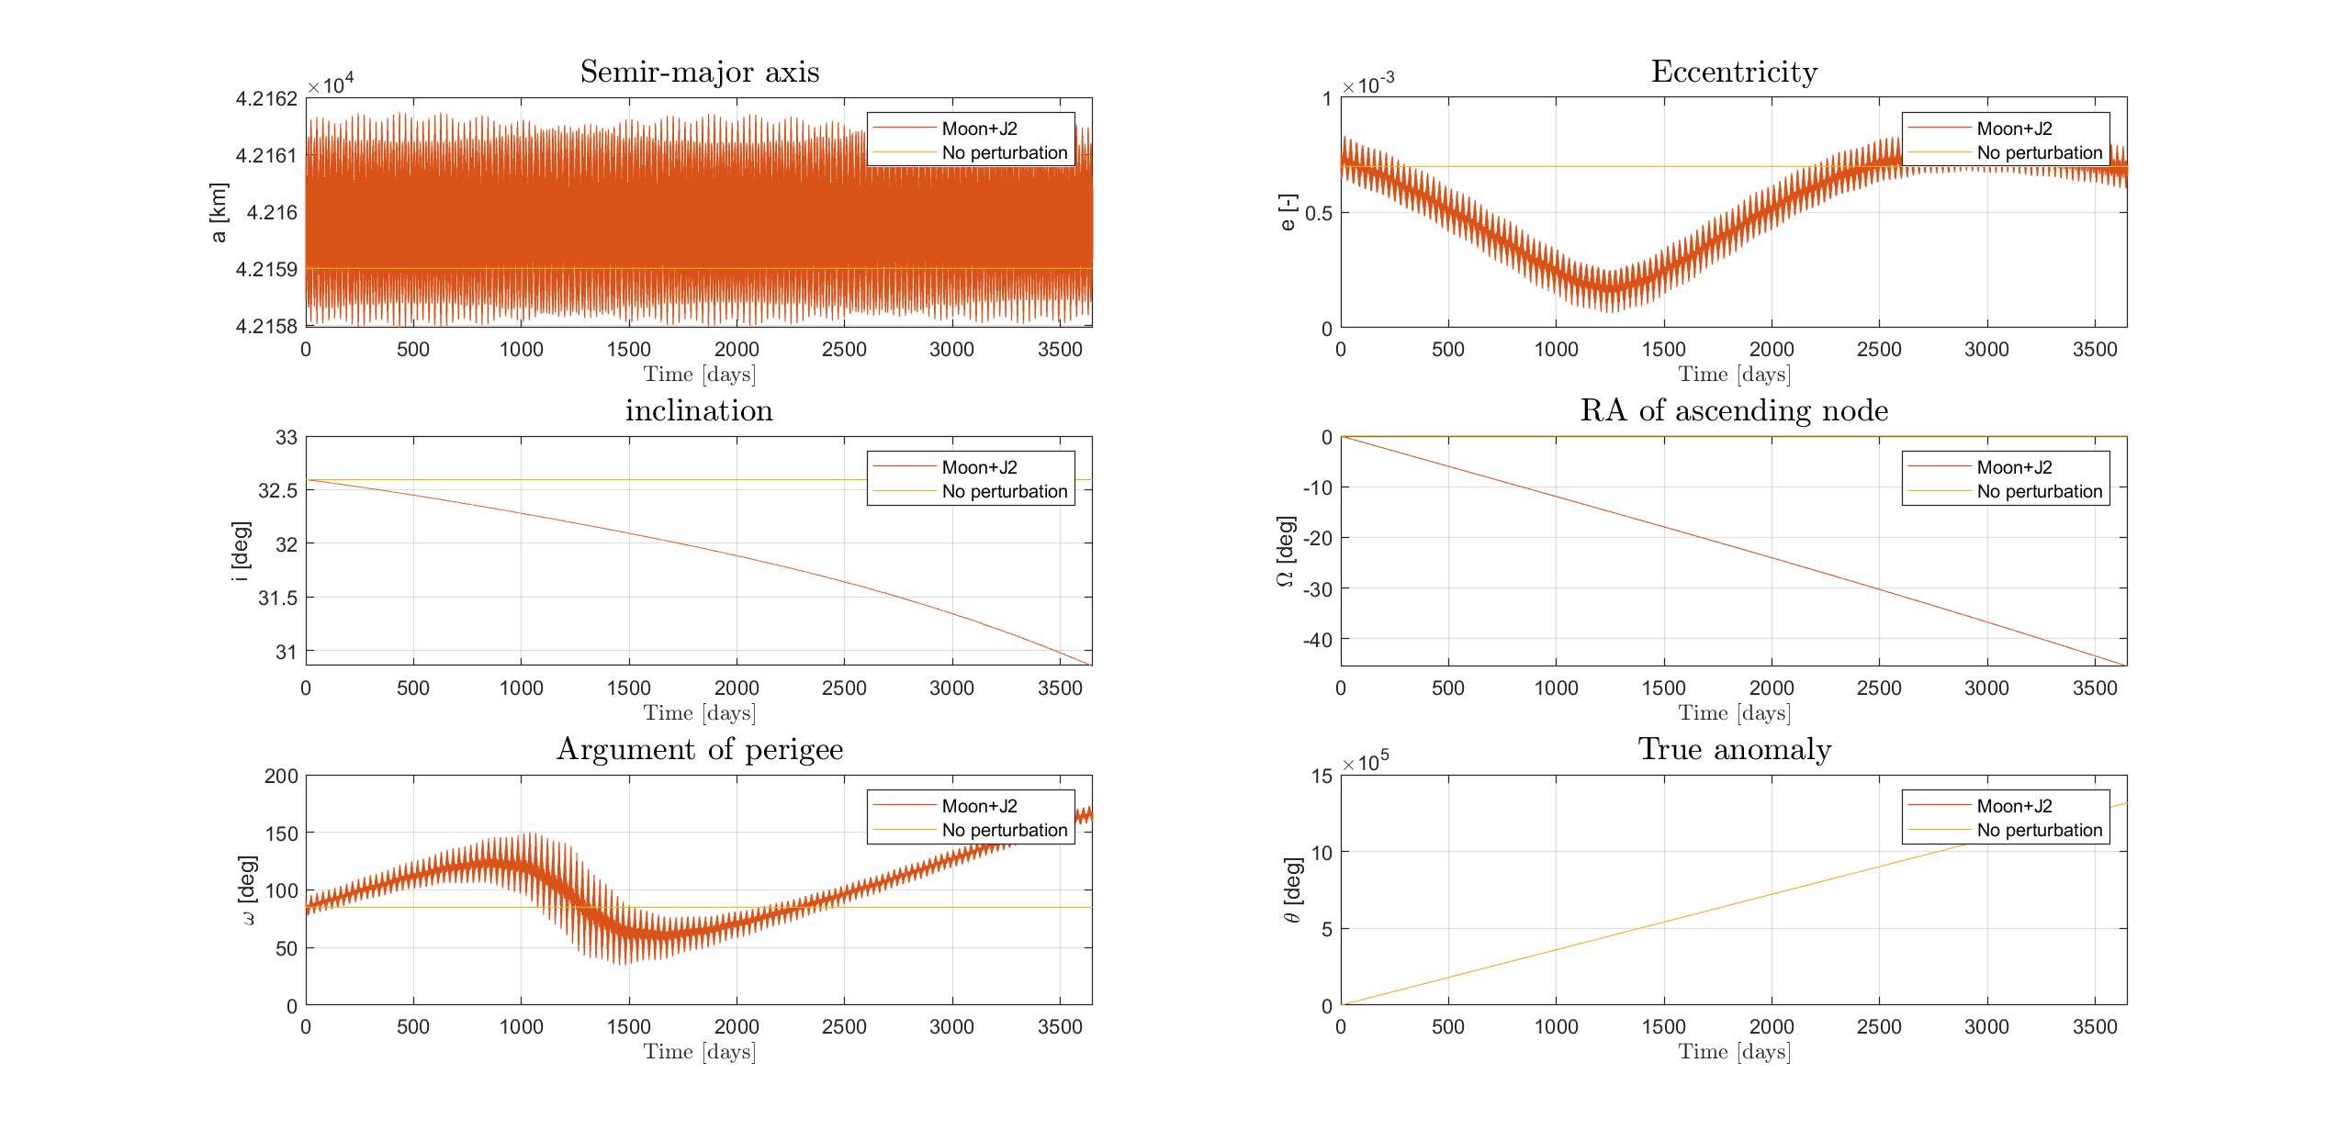
Keplerian Elements History

Slide 18
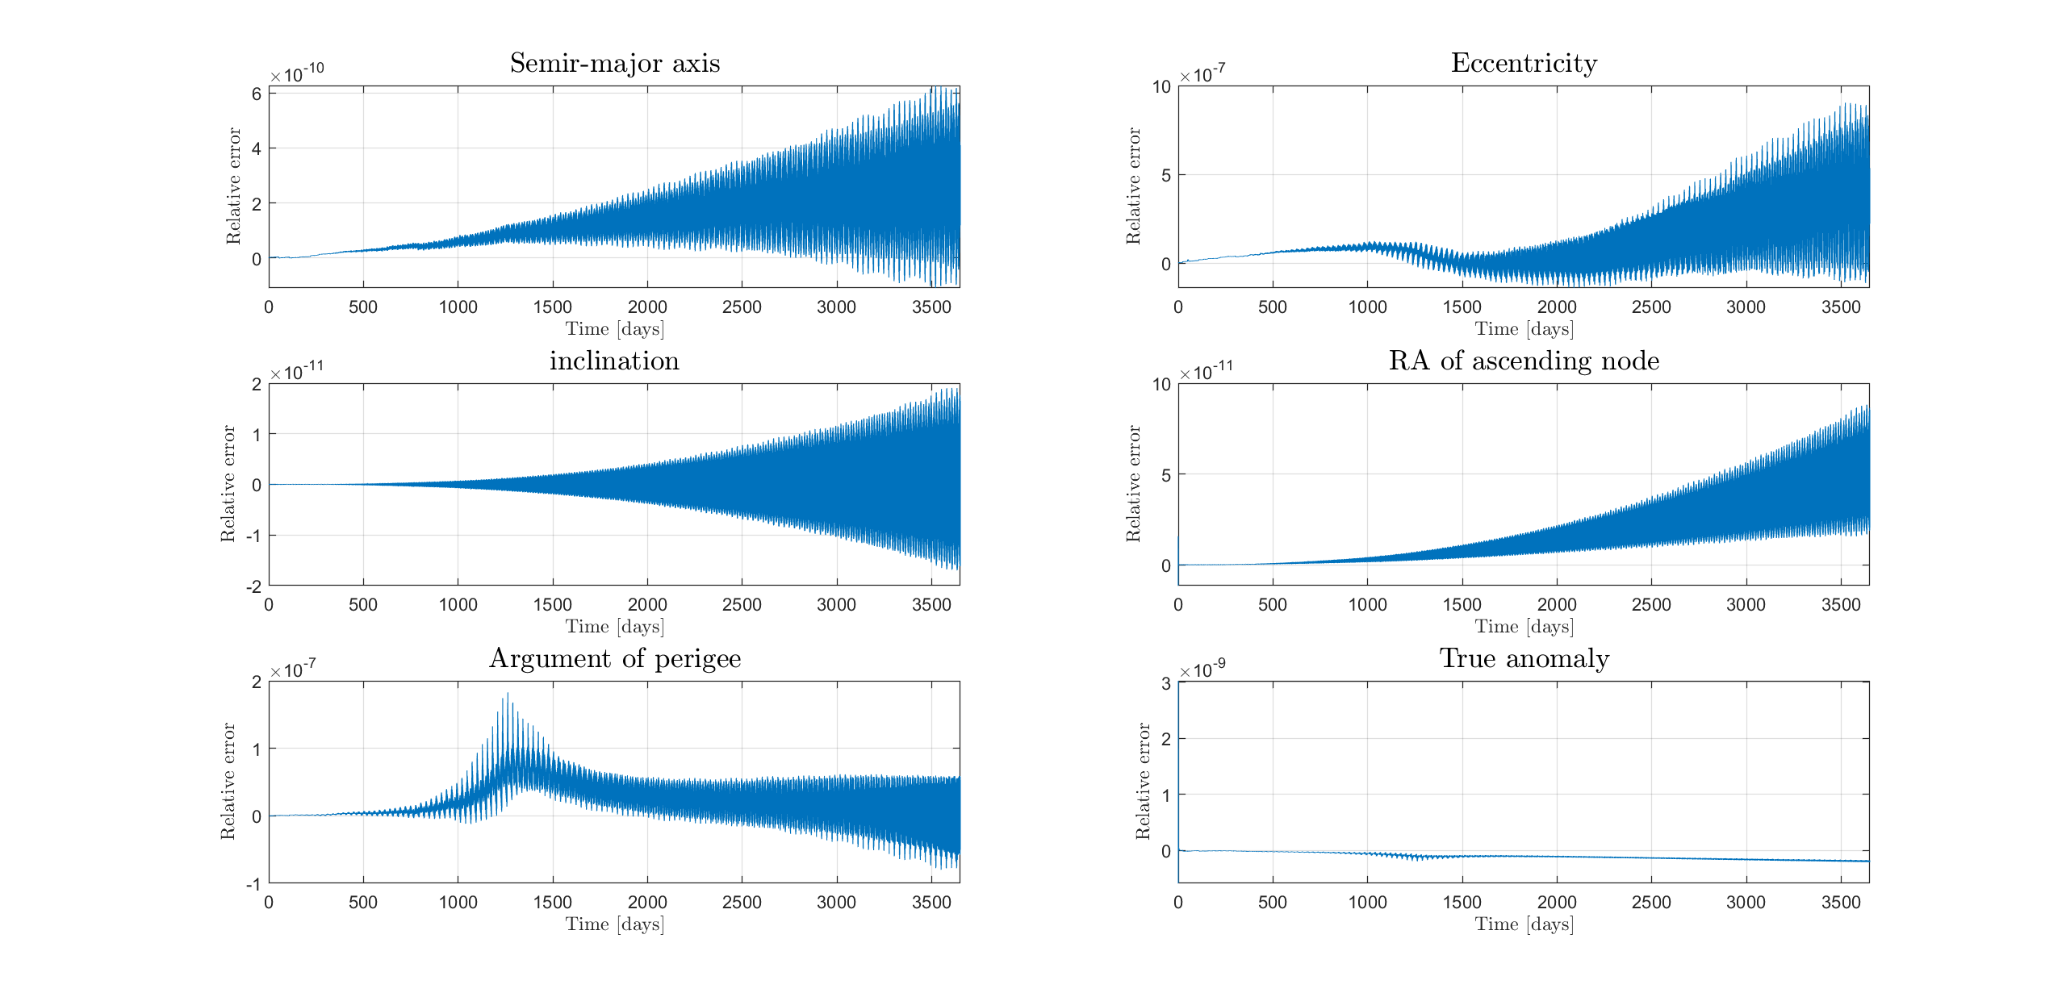
Relative Error

Slide 19
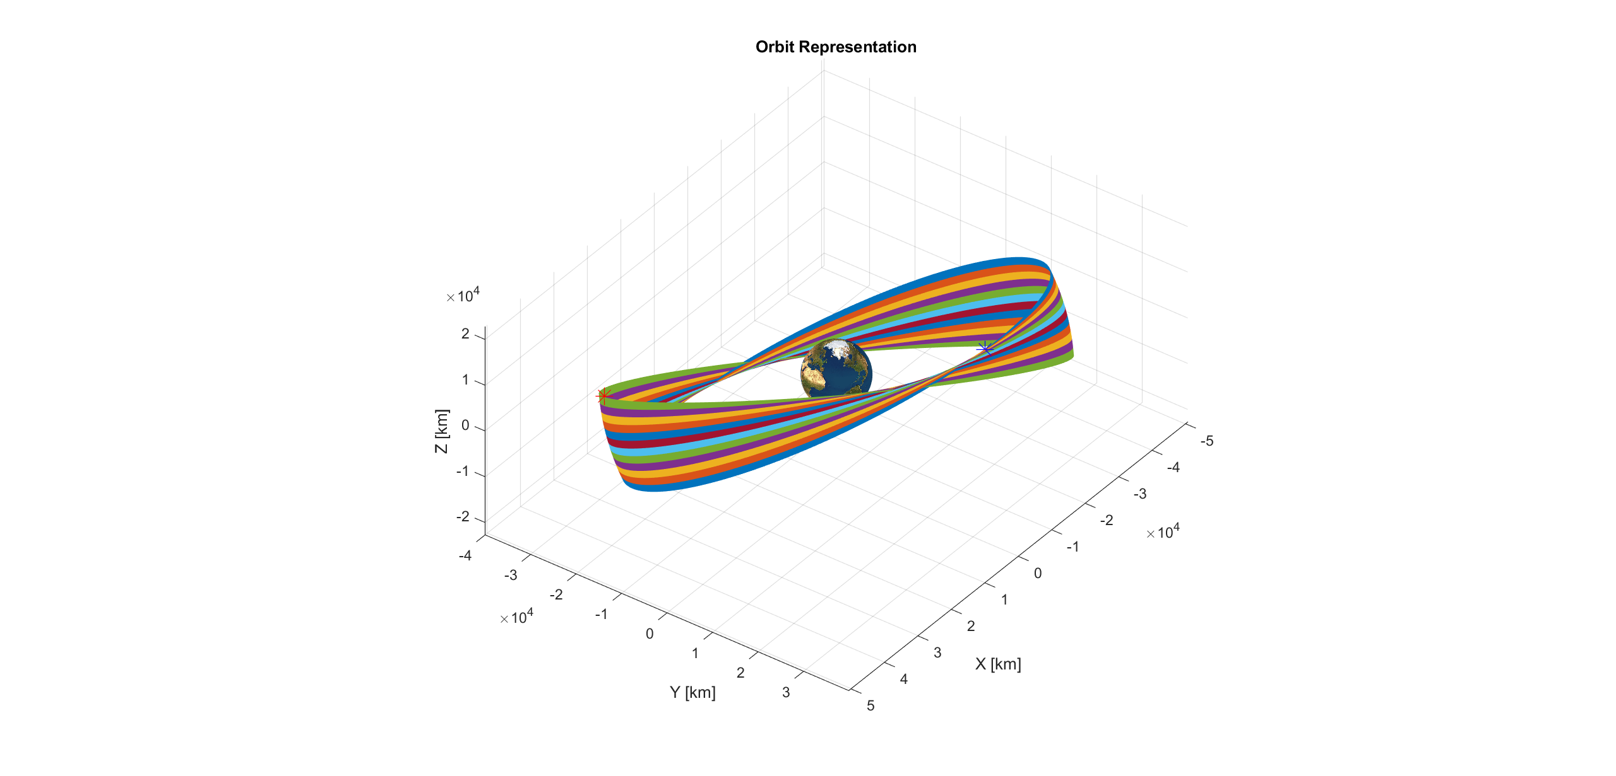
Orbit Evolution

Slide 20
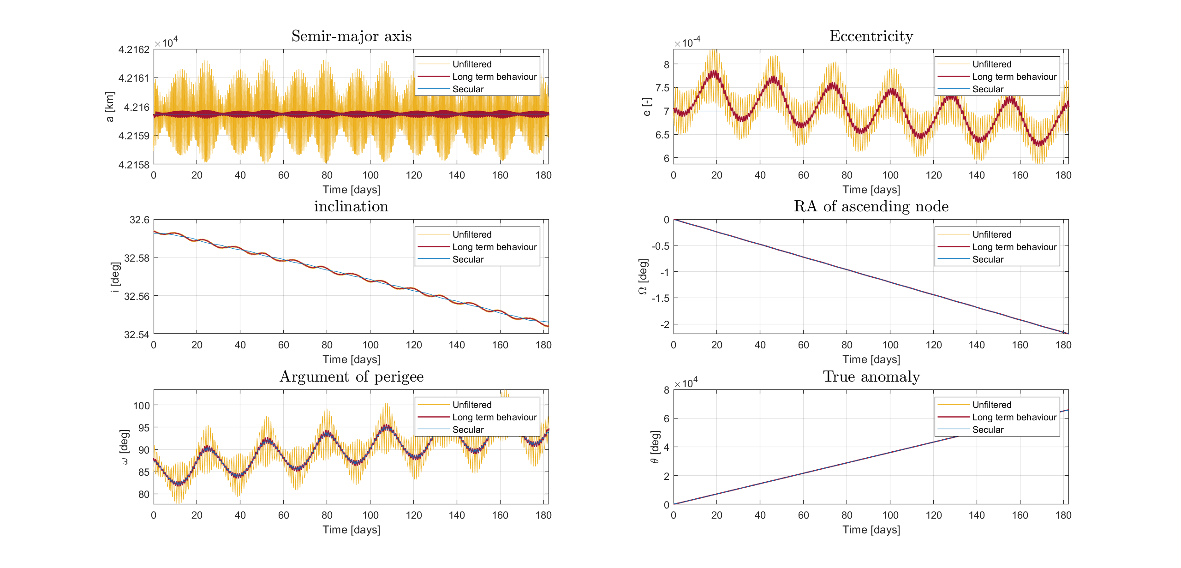
Filtering

Slide 21
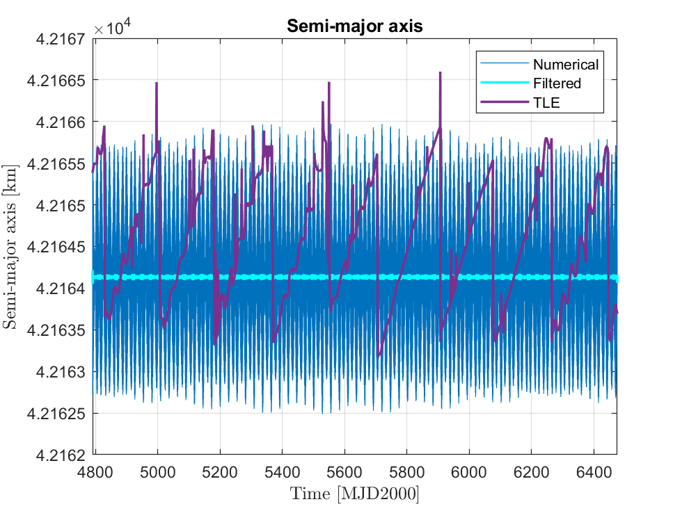
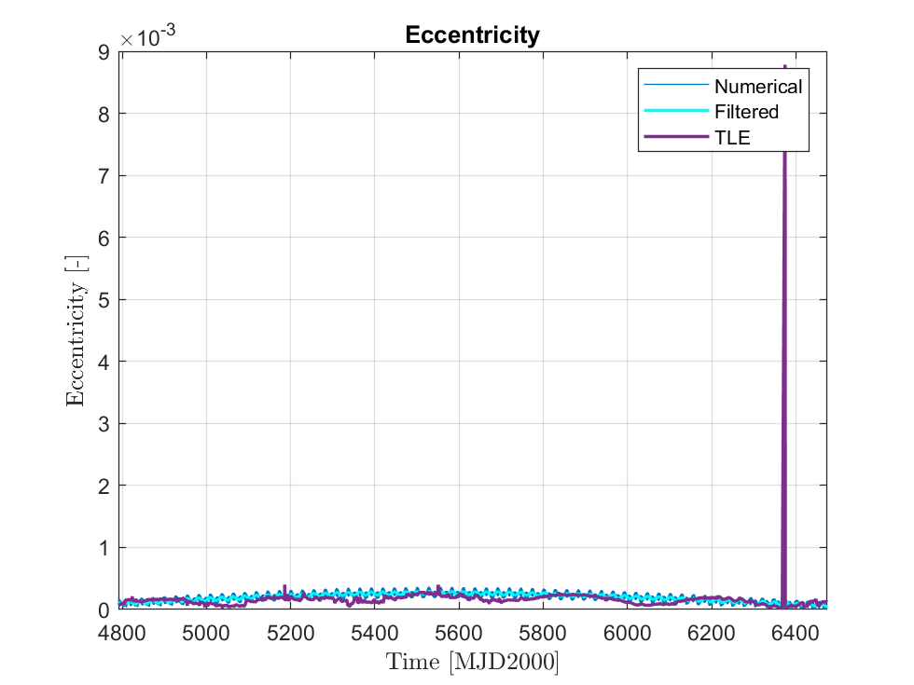
Comparison with Real Data (SDO)
a [km] | e [-] | i [deg] | Ω [deg] | ω [deg] | hp [km]
42165.384 | 0.000069 | 27.833 | 169.5864 | 245.7244 | 35783.9

Slide 22
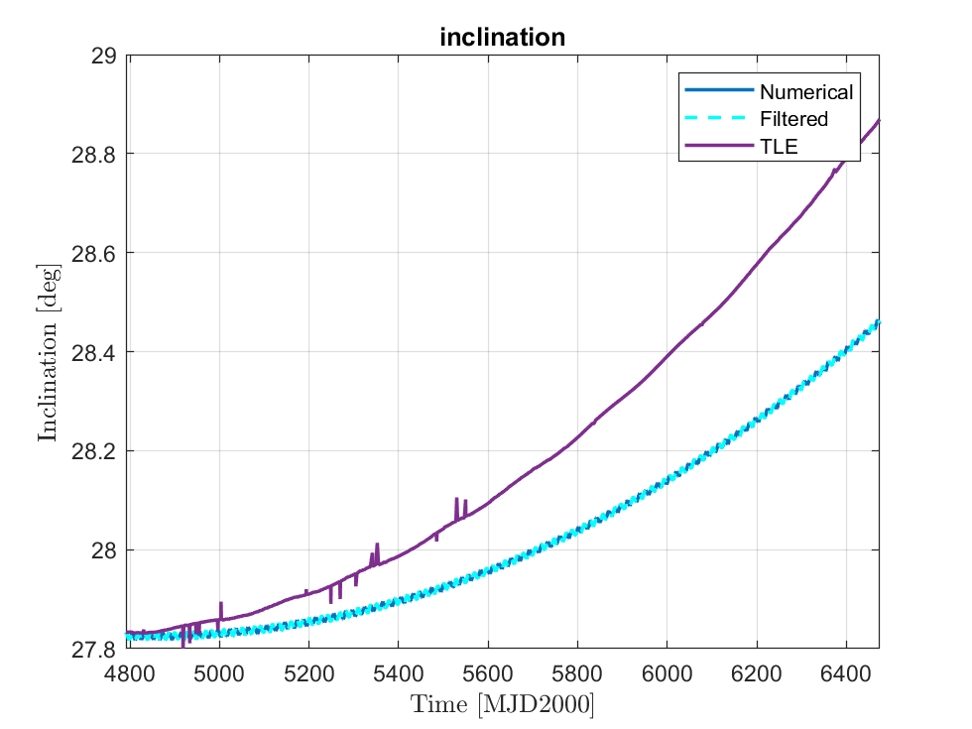
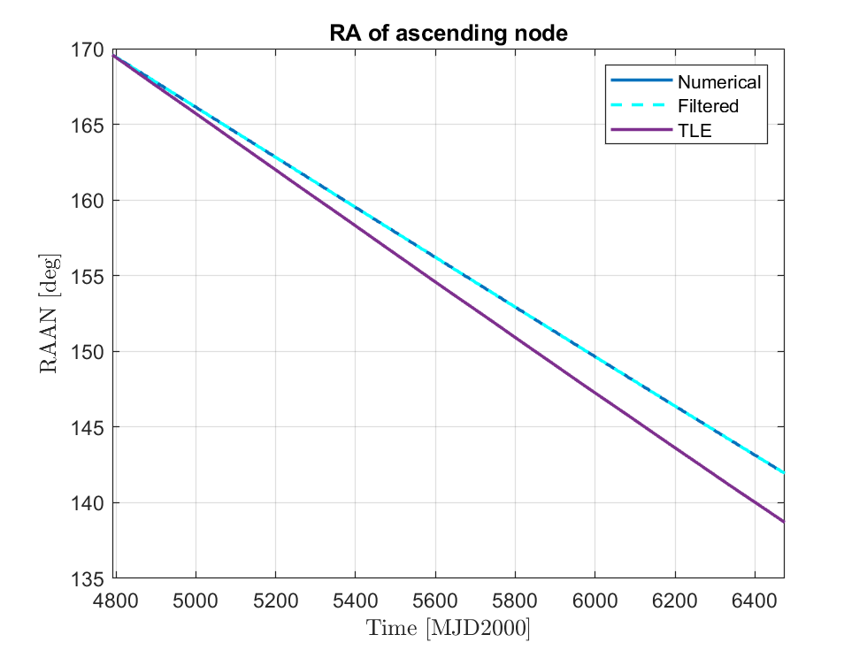
Comparison with Real Data (SDO)

Slide 23
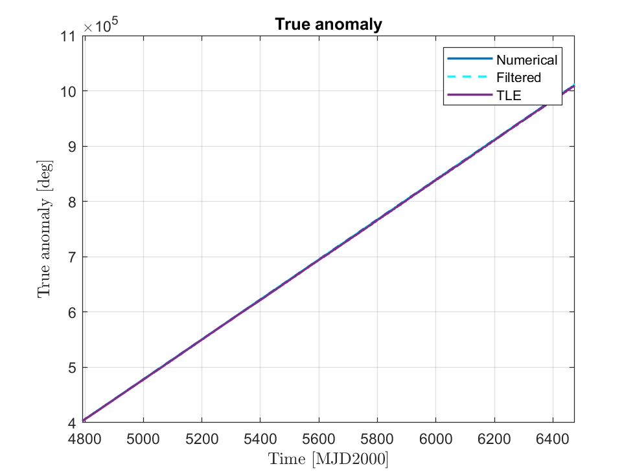
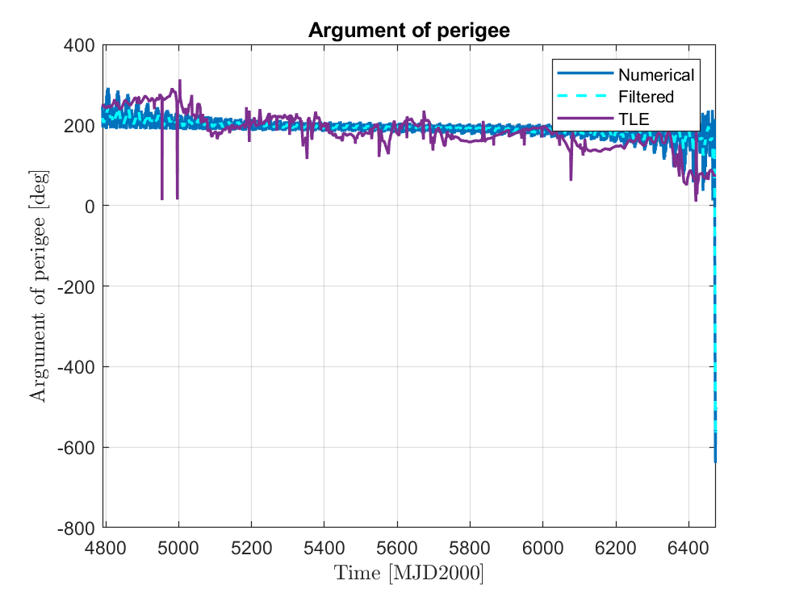
Comparison with Real Data (SDO)

